Slide 1
PROJECT
SYNOPSIS
MINOR PROJECT TCT-360
Submitted To:
Prof. C.S. Negi

Slide 2
THE TEAM AND THE ROLES
1. Muskan Kalra(Group Leader)
- Worked on adding the Javascript to the website and helped the team in both frontend and Backend.
2. Anirudh Kaul
- Designed the frontend( HTML, CSS )
3. Simran Chandna
- Worked in backend part of the website and made database models.
GROUP 10

Slide 3
TABLE OF CONTENTS
01
04
Introduction
Database designs
02
05
Platforms and Tools used
Problem Statement/Purpose
03
06
Project stages
References and Annexures
He

Slide 4
THE PROJECT-
E-Commerce Website

Slide 5
Problem Statement/Purpose
We are building a fully functional eCommerce website named BuyGadgets with user and guest checkout capabilities.
BuyGadgets has a stock of tech-related, digital and physical products.
We are providing functionality of store, cart and checkout form for filling the shipping address and making payment.

Slide 6
BuyGadgets
CSS
Features:
This product is a fully functioning eCommerce website from store to checkout functionality.
It has the ability for users to checkout as an authenticated user as well as a guest user.
Users will have the ability to add multiple products to cart, varying from physical to digital products.
Payment integration will be handled with PayPal, offering the ability to checkout with a PayPal account and with a PayPal debit/credit card.
Django
JS
HTML
Python

Slide 7
Github Link
Github link of the project source code:
https://github.com/Muskan0/ecommerce_project

Slide 8
PROJECT STAGES
2. Made the Database models
4. Guest-user Functionality
1. Made the templates
FINAL
VERSION
3. Authenticated user Functionality
5. Payment Integration

Slide 9
Setup and Templates
We created the Django project using Pycharm. Pycharm creates a virtual environment for us and provides ability to run the tasks of the manage.py utility.
We created the templates under templates/store in the store app.
Main.html → Template which all will inherit from
Store.html → Home page/store front with all products
Cart.html → Users shopping cart
Checkout.html → Checkout page
Inside store app in views.py file, we created views and rendered the templates we created. All the urls were created in urlpatterns list in url.py.
All the required css and styling were added. All the paths(static folder that contains css, images, js) were added to settings.py and other configurations had been done at this stage.

Slide 10
Building models
We created models in model.py and registered them to admin.py
All the models can be accessed from Django Administration page. A superuser was created to login to Django admin.
We used Pillow(Python Imaging Library) that helped us add the imagefield to our model.
get_or_create() method was used for creating the object if not existing already for objects of various models.
The products, orders, etc. were queried from the database to send them as a context to required templates. Then the required information is displayed.
We declared functions with @property decorator in models so it could be accessed like it's a regular property. This is used for many purposes, for example, looping through all the items to check if there is any physical product, or looping through all the items to calculate the total.

Slide 11
Authenticated User Functionality
The event handlers have been added for add to cart button, for increasing/decreasing quantity for order.
The process for updating cart-
Create an update_item view, we send the POST request of product and action related to product to this view.
This was done using Fetch API.
In the backend, We received the json response from the update_item, parsed it and updated our database.
Similar processes happen when order has been placed and we update our databases.
Features for hiding shipping address form (if no shipping is required), hiding name, email fields ( for authenticated users) have been added at this stage.

Slide 12
Guest User Functionality
For anonymous users we use javascript cookies to create the cart, for example:
{
"2":{"quantity":1},
"5":{"quantity":2}
}
The cookies are received in the backend as json objects:
cart = json.loads(request.COOKIES['cart’] ) )
, which can be parsed easily like python dictionaries.
The data we parse are sent to templates in frontend as a context, which then displays the required information.
Upon processing the order, we updated the database with the user form data (user information and shipping information) and the cart data.

Slide 13
Payment Integration
We used client-side integration of Paypal https://developer.paypal.com/demo/checkout/#/pattern/client
We are using sandbox accounts for developer purpose https://developer.paypal.com/developer/accounts/
Two accounts are used for that purpose-
Business account
Personal account
Website gives an alert when payment is confirmed.
Then returns to the store when order is confirmed and resets the cart, after the order has been done.

Slide 14
DATABASE

Slide 15
Database details
This project will consist of 6 Models, so let's summarize each one:
1. USER - Built in Django user model, instance created for each customer who registers.
2. CUSTOMER - Along with a User model, each customer will contain a Customer model that holds a one to one relationship to each user. (OneToOneField)
3. PRODUCT - The product model represents product types we have in store.
4. ORDER - The order model will represent a transaction that is placed or pending. The model will hold information such as the transaction ID, data completed and order status. This model will be a child of the customer model but a parent to Order Items.
5. ORDERITEM - An order Item is one item with an order. For example, a shopping cart may consist of many items but is all part of one order. Therefore the OrderItem model will be a child of the PRODUCT model AND the ORDER Model.
6. SHIPPING - Not every order will need shipping information. For orders containing physical products that need to be shipped we will need to create an instance of the shipping model to know where to send the order. Shipping will simply be a child of the order model when necessary.

Slide 16
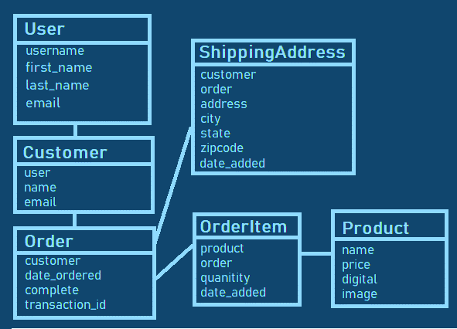
Database

Slide 17
Platforms and Tools Used
Pycharm 2020.3.1
Django 3.1.3
Python 3.8.6
HTML
CSS
JavaScript
Bootstrap
Pillow 7.1.1 (Python Imaging Library)
sqlite3

Slide 18
References
Django documentation
(https://docs.djangoproject.com/en/3.1/intro/tutorial01/)
JavaScript tutorials
(https://www.w3schools.com/js/default.asp)
CSS basics and tutorials-
https://youtu.be/yfoY53QXEnI
https://youtu.be/JJSoEo8JSnc
google.com
stackoverflow.com for fixing bugs and errors
geeksforgeeks.org for Django relational databases and various
other concepts.

Slide 19
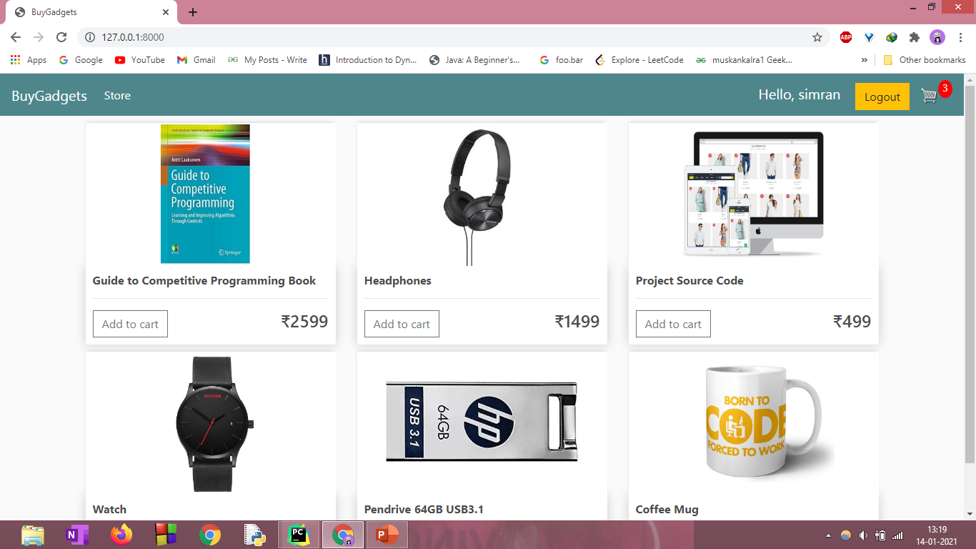

SCREENSHOTS OF THE PROJECT
STORE

Slide 20

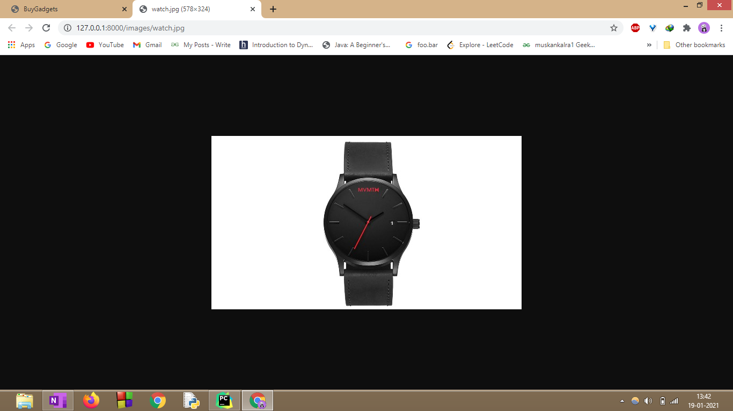

VIEW PRODUCTS

Slide 21
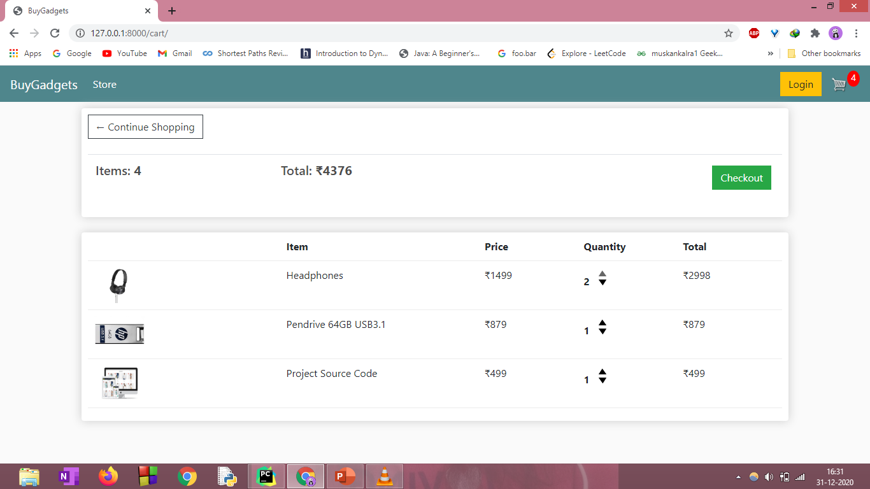
SHOPPING CART

Slide 22

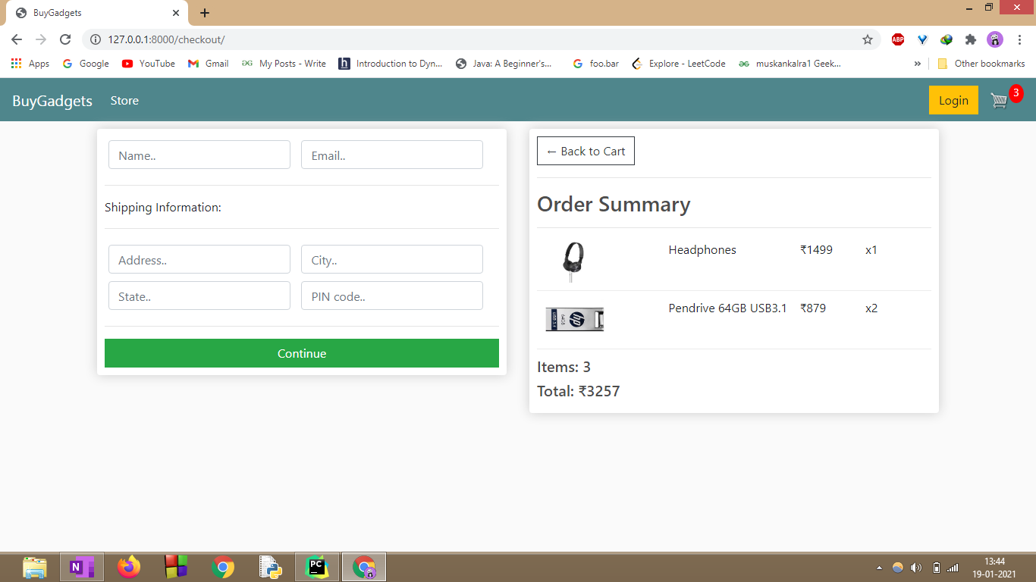

CHECKOUT

Slide 23
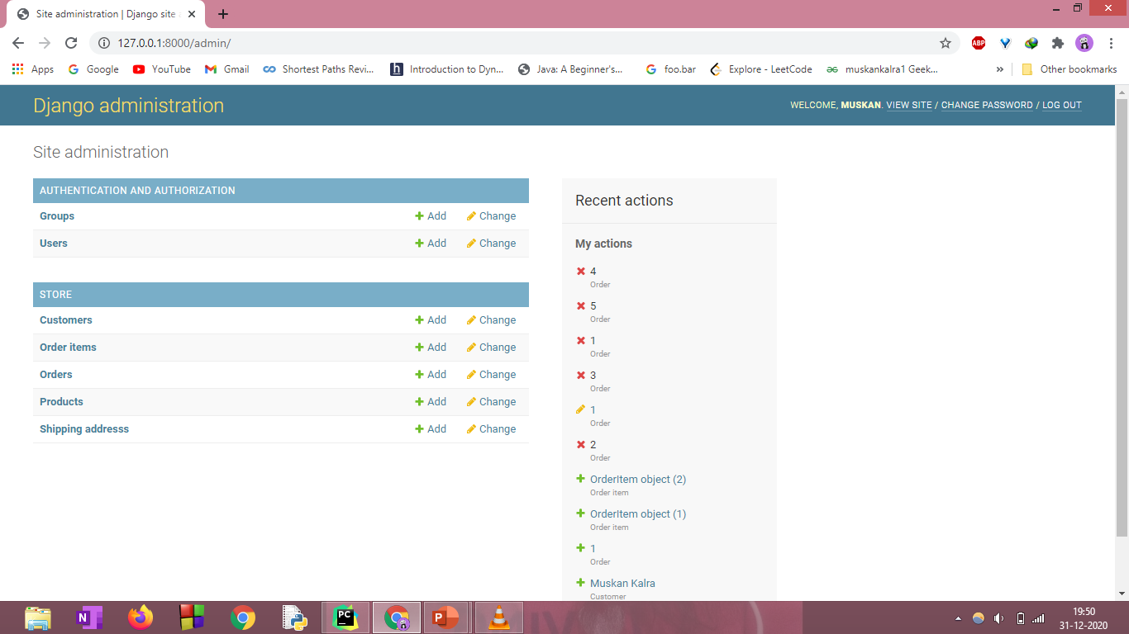
DJANGO ADMIN PAGE

Slide 24

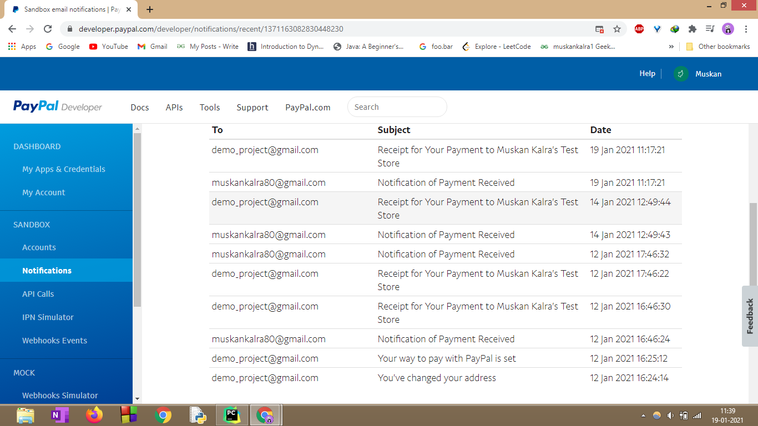
PAYPAL SANDBOX ACCOUNT

Slide 25
THANKS!

